Slide 3


NoSQL Data Architecture and Types
By Anish Kumar – 1AY21CS028

Slide 4

What is NoSQL Data Architecture?
NoSQL Data Architecture is for
Unstructured or Semi-structured data.
Offering Flexibility, Scalability, & High Performance.
Characteristics of NoSQL Data Architecture
Schema-Less Design
Horizontal Scalability
CAP and BASE Models
Support for Various Data Models

Slide 5
Types of No SQL Data Bases
Key-Value Store
Column-Family Stores
Document Stores

Slide 6
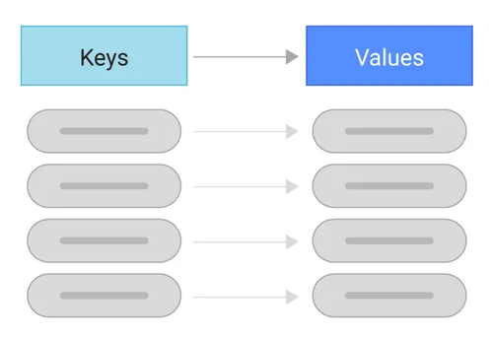
What is Key Value Store?
The Key-Value Store is one of the simplest types of NoSQL data architecture patterns, used for high-performance and scalable data storage.

Slide 7
Characteristics of Key Value Store.
High Performance: key-value stores can handle large volumes of data and high request rates.
Scalability: Key-value stores scale horizontally by adding more nodes, which helps in managing extensive data and increasing system load.
Flexibility: This system stores data in a format without a fixed schema, which allows for any type of data in the value field,
Eventual Consistency: Often, key-value stores operate under eventual consistency, meaning updates to data will propagate to all nodes over time.

Slide 8
Key Value Store Operations.
Get(key): Retrieves the value associated with a specific key.
Put(key, value): Stores a value associated with a key, updating it if the key already exists.
Delete(key): Removes a key and its associated value from the store.

Slide 9
Limitations of Key Value Store.
No Indexing: Values are not indexed, so searching within a subset of values is limited.
Limited Query Capability: Unlike relational databases, key-value stores do not support complex queries with filters or joins.
Data Uniqueness: As data volume grows, maintaining unique values for keys can become more complex.

Slide 10
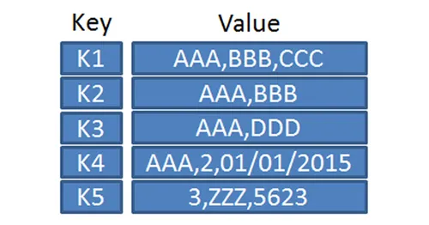
Examples of Key Value Store
Redis: An in-memory data store known for high-speed caching, real-time analytics, and session management.
Amazon DynamoDB: A fully managed NoSQL database by AWS, designed for web applications needing scalable and low-latency data access.
Riak: A distributed database optimized for high availability and scalability, commonly used in IoT and e-commerce applications.

Slide 11

What is Document Store?
The Document Store is a type of NoSQL database that stores data in a flexible, schema-less format, allowing each document to have a unique structure.
Document stores are highly suitable for managing unstructured or semi-structured data, such as JSON or XML files.

Slide 12
Characteristics of Document Store
Unstructured Data Storage: Document stores are designed to manage unstructured or semi-structured data without a rigid schema.
Nested Hierarchies: Data is stored in nested structures, typically in JSON, BSON, or XML formats. This structure supports complex, hierarchical information within a single document.
ACID Transactions: Some document stores support transactions with ACID properties, ensuring data reliability and consistency during updates.

Slide 13
Characteristics of Document Store
Easy Querying: Documents can be queried based on contents, allowing for searches using document paths, without needing object-relational mapping.
Dynamic Schema: Document stores are schema-less, making it easy to add new fields without predefined schema adjustments.

Slide 14
Architecture and Data Storage
Documents as Main Storage Units: Each document in the database contains all the data for a given entity or object, eliminating the need for multiple tables or relations.
Collections: Documents are grouped into collections, which serve a similar purpose as tables in relational databases but allow for diverse document structures.
Indexes: Document stores often support indexing on document attributes, providing efficient searching and querying capabilities.

Slide 15
Limitations of Document Store
Consistency Challenges: Document stores prioritize availability and scalability, sometimes compromising on strict consistency, which can affect applications needing strong consistency guarantees.
Performance in Complex Joins: Document stores are less optimized for scenarios requiring complex joins across multiple documents.
Data Redundancy: Embedding data in documents can lead to redundancy, especially when data changes frequently across documents.

Slide 16
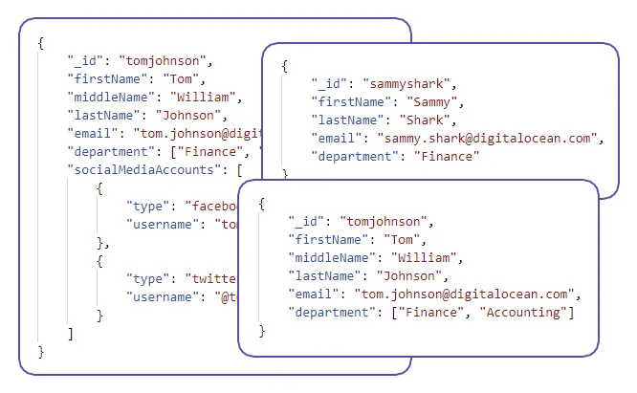
Examples of Document Store
MongoDB: which stores data in flexible, JSON-like documents and is commonly used for applications requiring dynamic schema, such as
content management systems,
catalogs,
real-time analytics.

Slide 17
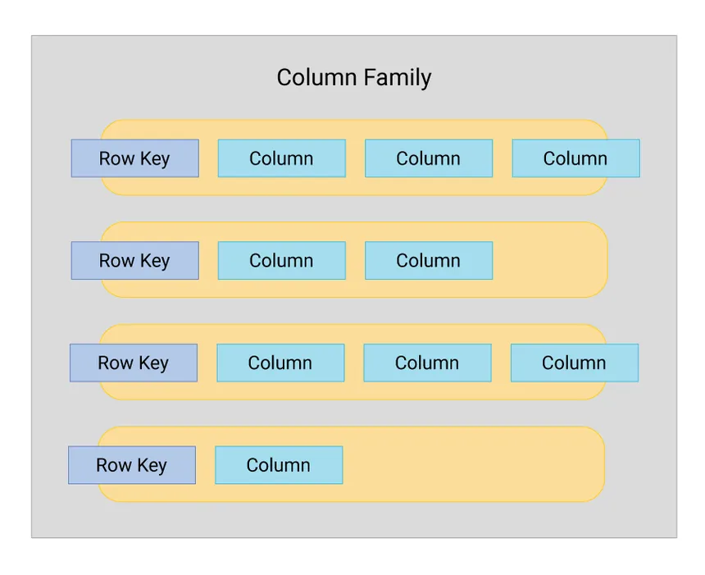
What is Column-Family Store?
The Column-Family Store in NoSQL databases organizes data into groups of related columns, known as column families.
Handling sparse datasets where some columns may not have values in every row, as it only stores data where values exist.

Slide 18
Characteristics of Column-Family Store
High Scalability: Designed to scale horizontally by distributing data across multiple nodes, supporting large datasets.
Partitionability: Column-family stores can partition large datasets into smaller groups of rows for parallel processing across nodes.
Tree-Like Structure: Data is organized hierarchically, where columns are grouped into families, and families can be further grouped into column groups or super-columns.

Slide 19
Characteristics of Column-Family Store
Efficient Storage for Sparse Data: Only non-empty values are stored, optimizing memory use and storage.
Replication and Fault Tolerance: Data can be replicated across nodes, enhancing availability and reliability.
Efficient Analytics: In-memory analytics are faster due to column-based data storage, allowing for efficient access to specific fields needed for queries.

Slide 20
Architecture and Data Storage
Column Families: A column family in a column-family store is similar to a table in a relational database, but with a significant difference. Each row in a column family can have its own set of columns.
Super Columns: Some implementations, such as Cassandra, support super columns, which allow for nested column families. Super columns organize data hierarchically, grouping similar columns together.

Slide 21
Limitations of Column-Family Store
Limited Query Language: Unlike SQL, the query language for column-family stores is often restricted to basic operations (e.g., inserts, updates, deletes) and lacks complex query support.
Complicated Data Model for Nested Queries: Although column-family stores can handle nested data with super columns, this structure can become complex and challenging to maintain.
Complexity in Data Management: Managing data partitioning, replication, and consistency settings can require significant configuration to ensure optimal performance and fault tolerance.

Slide 22
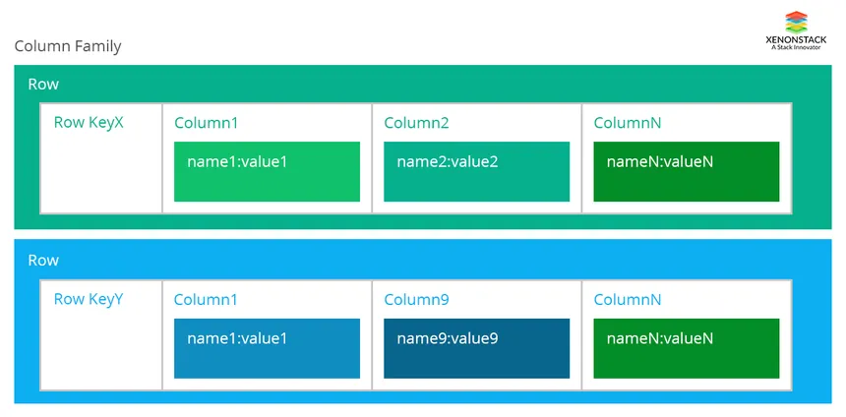
Examples of Column-Family Store
Apache Cassandra, which is designed to handle large volumes of structured data across many servers
Commonly used for time-series data, logging, and real-time analytics applications.

Slide 23


